Slide 1
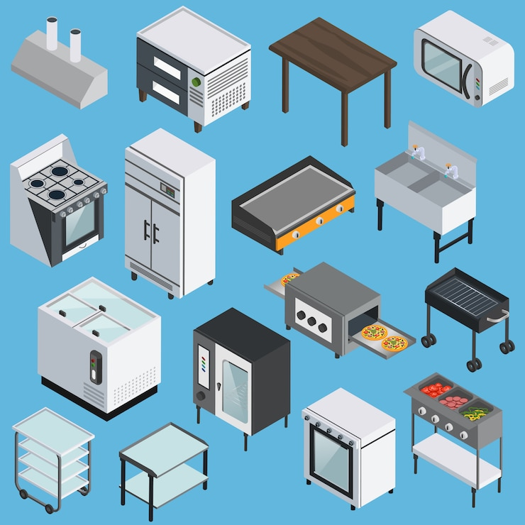
Equipment Board Number Placement Guidelines
For Food Service Managers

Slide 2
Brief Description
This presentation provides clear guidance on where to place board numbers on various types of food service equipment.
Over the next few slides, you’ll see:
Examples of correct board number placement
Best practices for visibility and durability
Equipment-specific instructions (e.g., mixers, warmers, slicers)

Slide 3
What is a Board Number
A Board Number is a unique identification number assigned to each piece of food service equipment.
It is used by the district to:
Track equipment for inventory and asset management
Schedule and record maintenance or repairs
Ensure accountability across sites
Support compliance with internal audits and inspections
Examples of Board Numbers:

Slide 4
Directions
1. Find the Placement Location
Find a flat, visible surface on the equipment.
Use the power-point to follow where to put your board #'s.
Avoid surfaces that get hot, dirty, or are frequently handled.
2. Clean the Surface
Wipe down the area with a clean cloth to remove dust, oil, or grime.
3. Plan the Sticker Placement
Hold the sticker over the cleaned area to check positioning.
Use a ruler if you want it to be centered or aligned perfectly.
Make sure the sticker won’t cover important labels, buttons, or indicators.
4. Peel the Sticker
Carefully peel the backing off the sticker.
5. Apply the Sticker
Align the edge of the sticker with the chosen spot.
Press down from one end to the other to avoid bubbles.
Use your fingers to smooth it out.
6. Final Check
Make sure it's firmly pressed down with no loose edges or air bubbles.
Let it sit for a few hours before handling the area if possible.

Slide 5
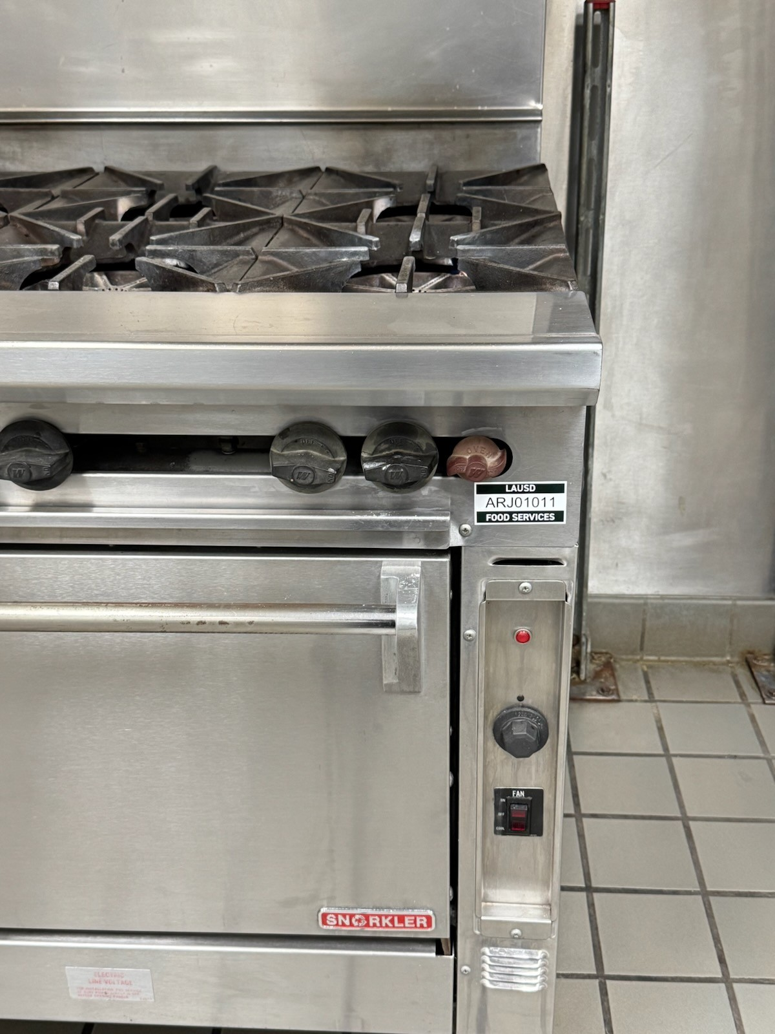
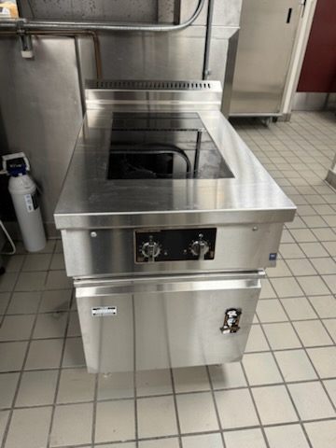
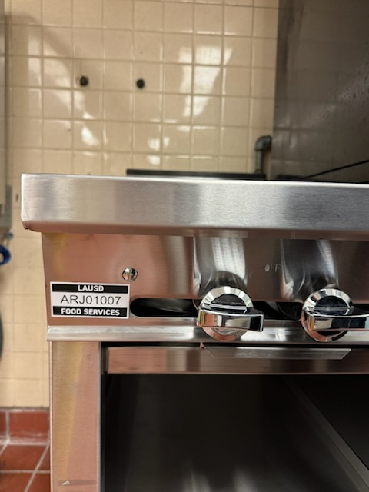
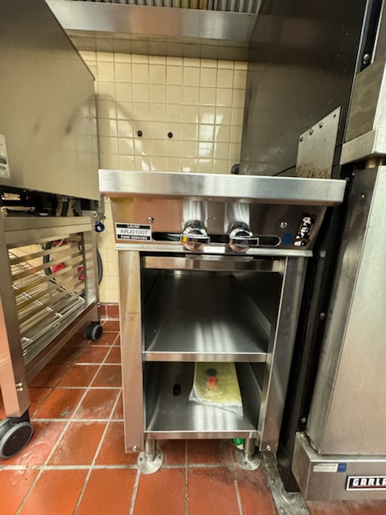
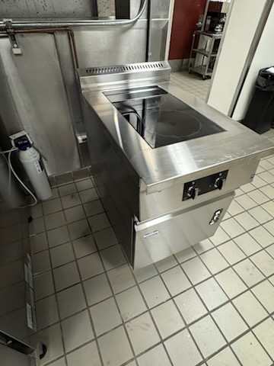
Ranges/Induction Ranges
As shown in the picture, place the Board # either on the right or left side of the Range.
Make sure it is in a clear area, not blocking any other information.

Slide 6
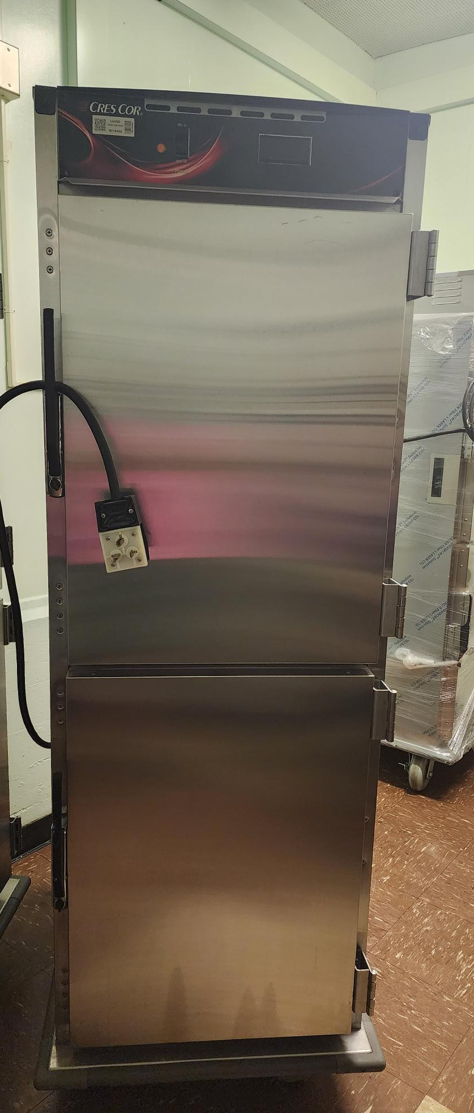
Hot Food Cabinets
Place Here
Place Board # on top of Hot Food Cabinet.
Make sure you aren't covering anything and place in a clear spot.
Don't place Board # while the Hot Food Cabinet is on or in use.
Use step stool if necessary or ask plant manager for help if you can't reach.

Slide 7
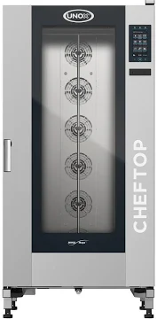
Combi Ovens
Place Board # on the left or right side of the Combi Oven.
Make sure to not cover any of the equipment model or serial # information.
Please place Board # when the Oven is not in use.
Place Here

Slide 8
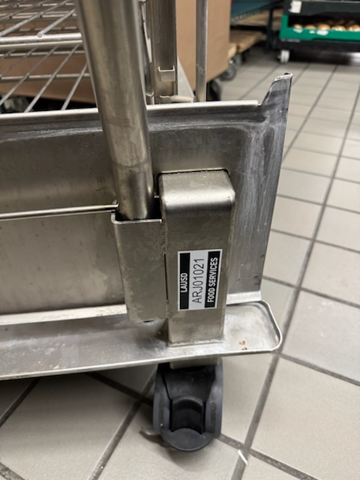
Trolleys
Please place Board # on the bottom of the trolley on either the left or right side, as shown in the picture.
Please remove the trolley from the Combi Oven before placing the Board #.
Place Here or Place Here

Slide 9
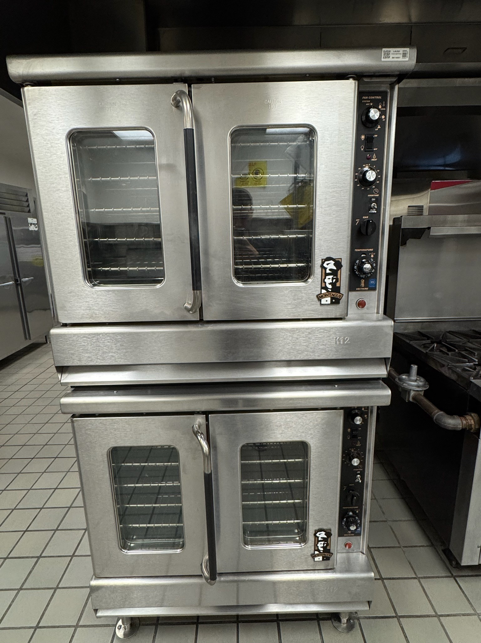
Convection Ovens
Place Board # on top of convection, as shown in the picture.
Please make sure Oven is off before placing Board #.
Don't place the Board # on the door or on the side of the oven.

Slide 10
Share Cart
Please place Board # on the side of the Share Cart where the handle is, as shown in the picture.
Don't cover any other stickers on the cart.

Slide 11
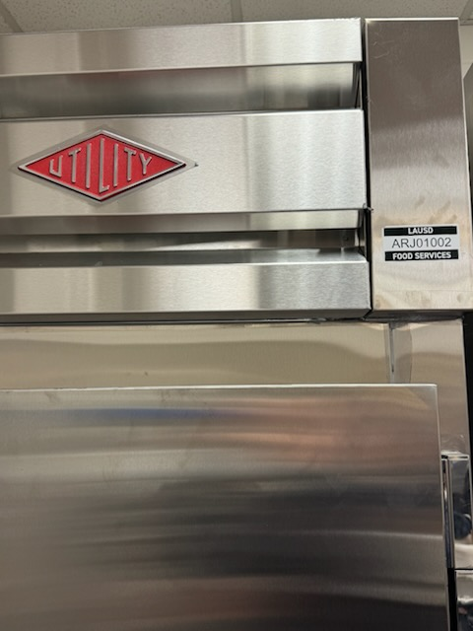
Freezers & Refrigerators
Please place Board # on top of the Freezer/Refrigerator, as shown in the picture.
These board #'s are not for your walk-in refrigerator/freezer.
Use step stool if needed or ask plant manager for help, if needed.

Slide 12
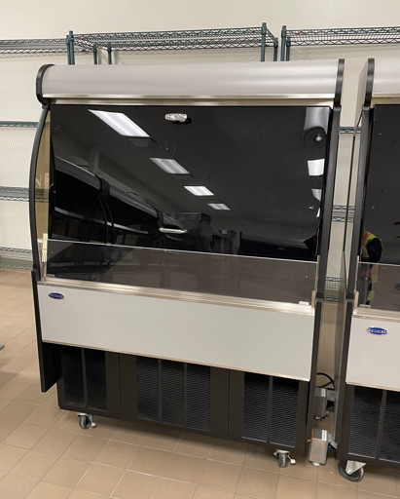
Cold Merchandiser
Place Board # behind the cold merchandiser as shown on the picture.
Don't place on the door.

Slide 13
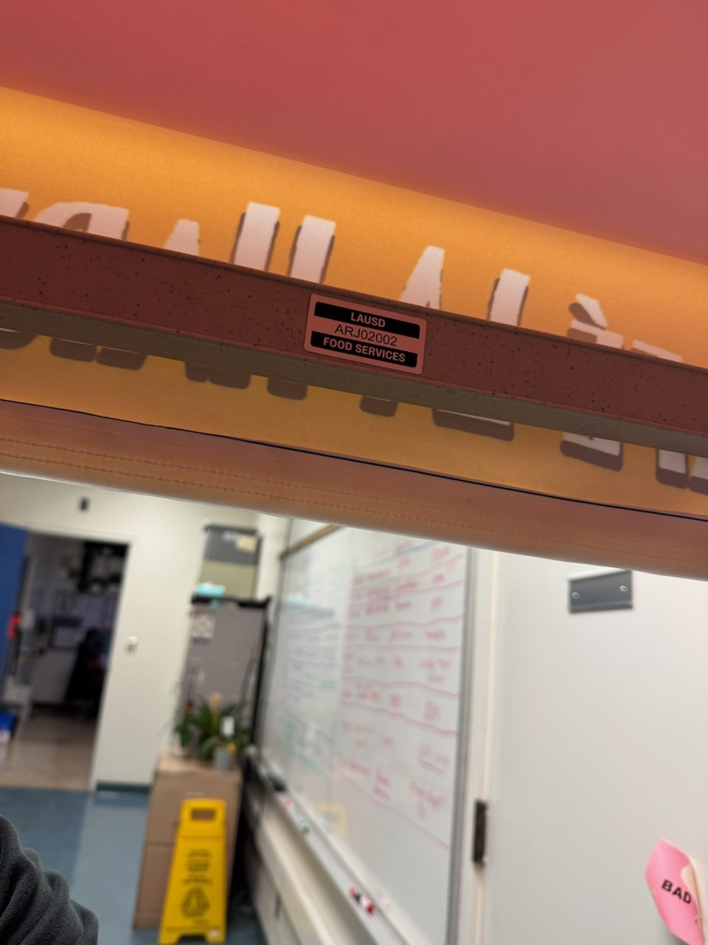
Harvest Stand
Place Board # on top on the back bar on shown on the picture.

Slide 14
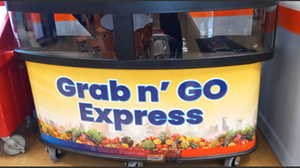
Campus Cruiser
Place Board # behind the Campus Cruiser.
Place in a clear area.
Place Here

Slide 15
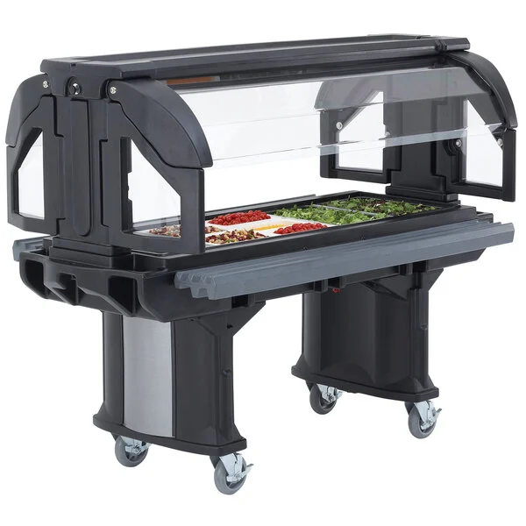
Salad Bar
Place Here
Place Board # on the side of the Campus Cruiser.
Place in a clear area.

Slide 16
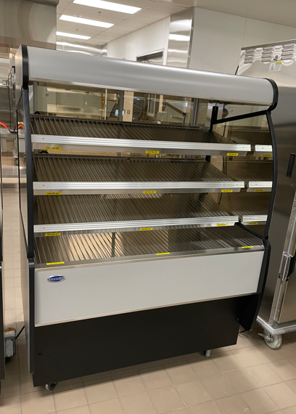
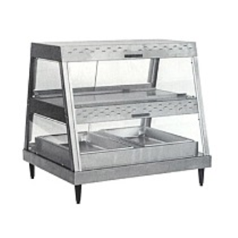
Hot Merchandiser
Place Board # behind the Hot Merchandiser on the bottom as shown in the picture
Please have the unit turned off before placing Board #
Place Here
Place Here

Slide 17
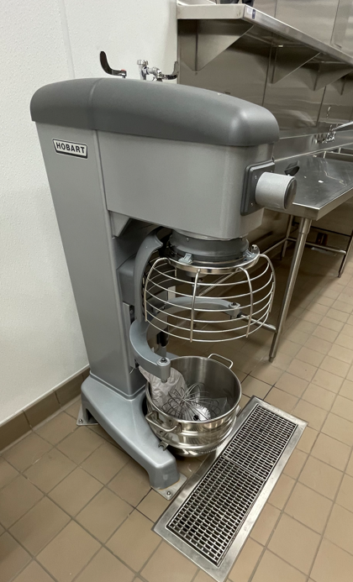
Mixers
Place Board # on the side of the mixer as shown in the picture.
Please make sure the mixer is off before placing Board #

Slide 18
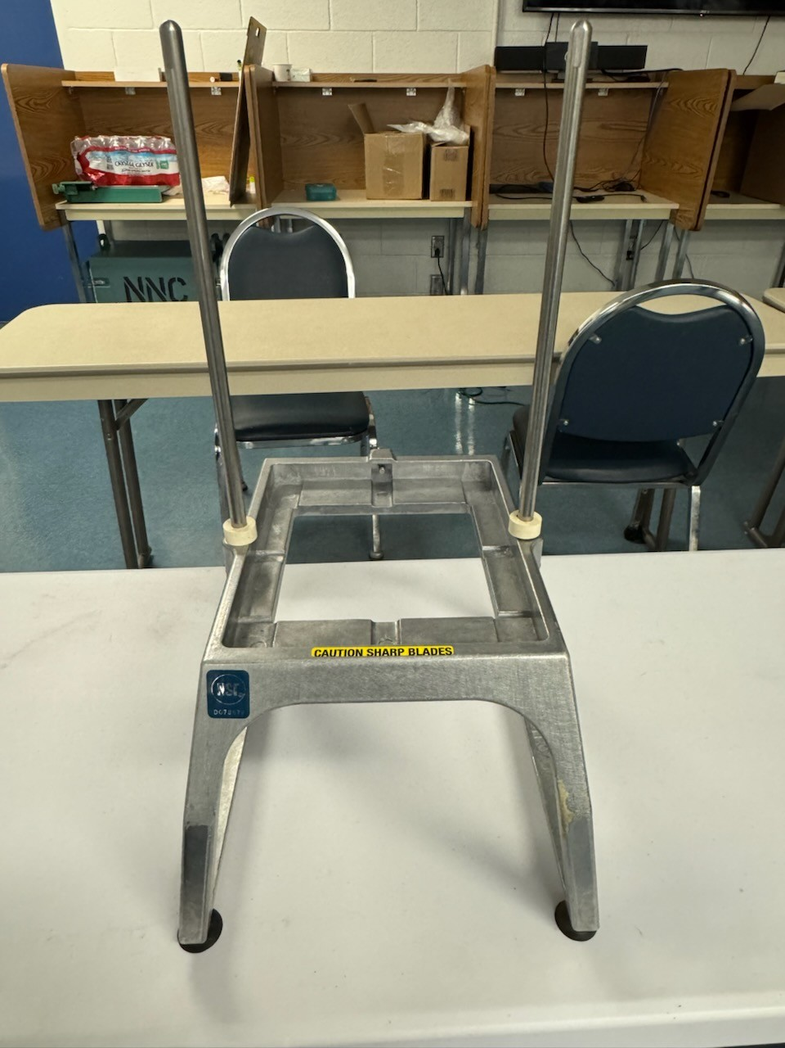
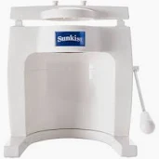
Vollrath Food Processor
Place Board # underneath the Vollrath.
Please don't cover any information underneath. Place in clear area.
Don't have any blades inserted in unit when doing this.
Sunkists will not have Board #'s

Slide 19
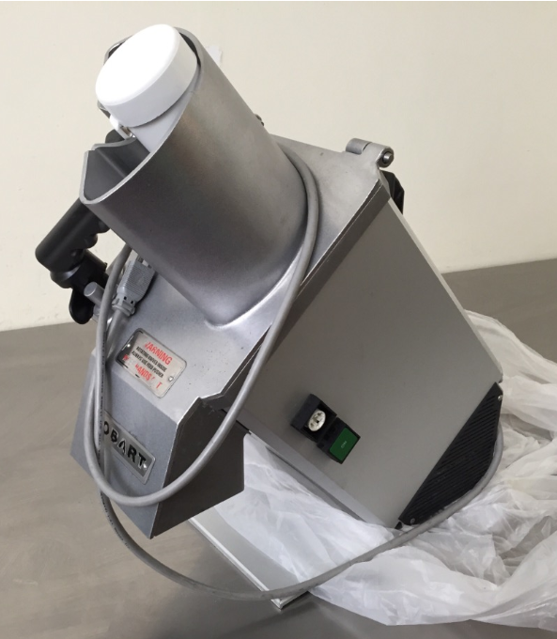
Food Sectionizer
Place Board # on the side of the Food Sectionzer, as shown in the picture
Make sure unit is unplugged when placing Board #
Make sure it is in a clear area and not covering any information
Place Here

Slide 20
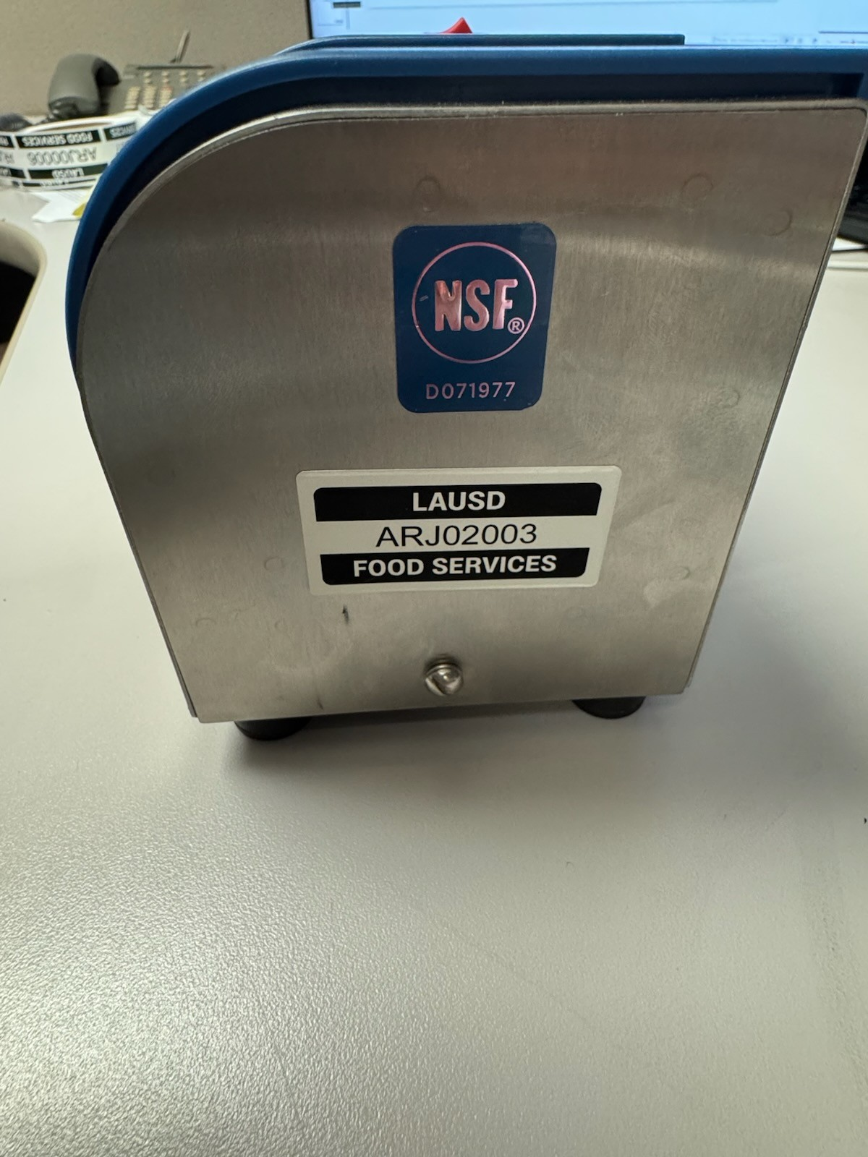
Knife Sharpener
Place Board # on the right side of the knife sharpener, as shown in the picture.
Make sure knife sharpener is unplugged before placing board #.

Slide 21
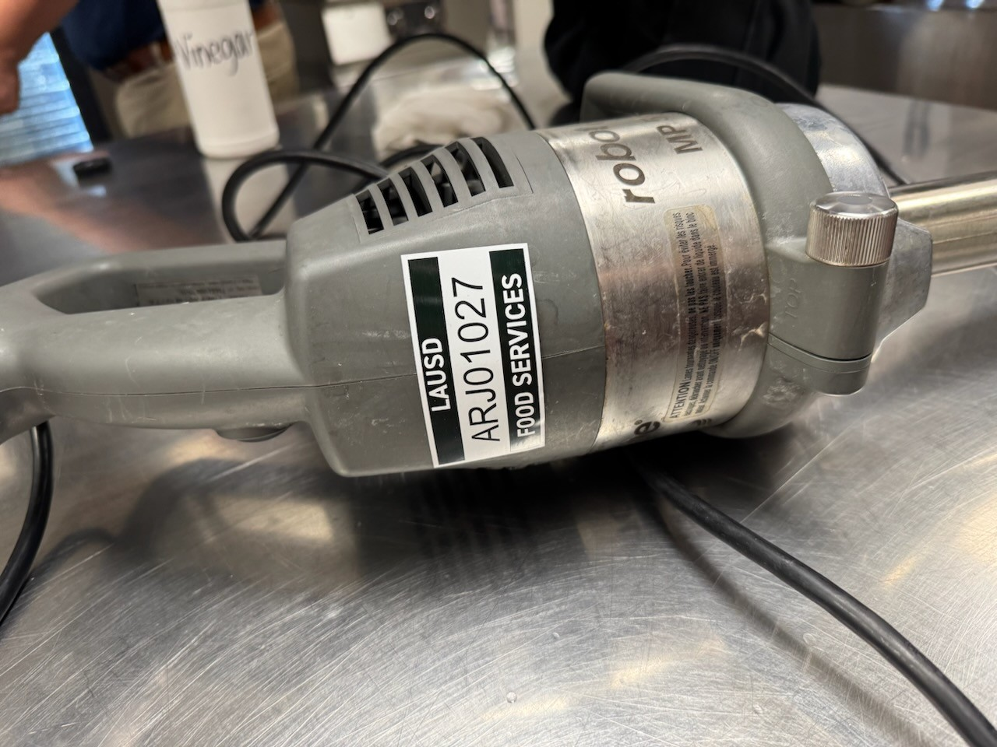
Immersion Blenders
Place Board # as shown in the picture.
Place in clear area.
Make sure unit is unplugged before placing the Board #.

Slide 22
AccuTemp Steamer
Place Board # on the side of the steamer, as shown in the picture.
Place Here

Slide 23
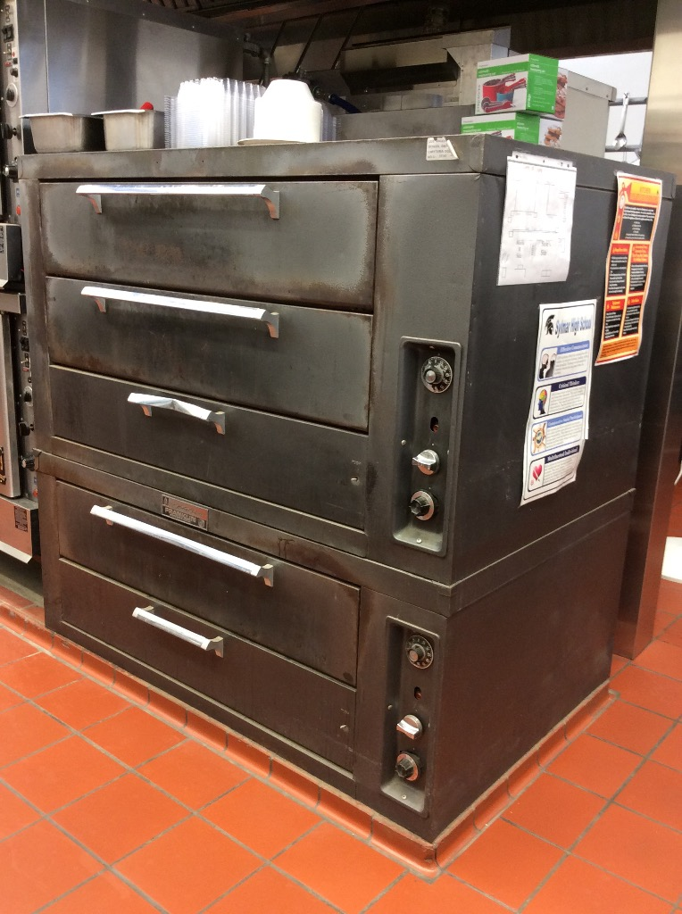
Steamers
Place Here
Depending on the steamer you have please place the board # correctly as shown on the pictures.
Please make sure steamers are off when doing this.
Place Here

Slide 24
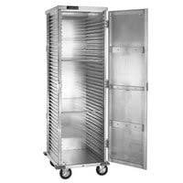
Bun Pan Racks – Full Size and Enclosed
Place Board # on top of rack on the side as shown in the picture for the Full-Size Rack
Place Board # on top, in front of the Enclosed Rack, as shown in the picture
Board #'s are only for the new racks you will be receiving starting May 2025
Place Here

Slide 25
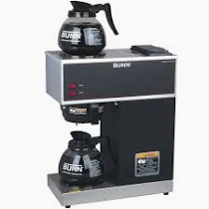
Fetco Coffee Maker
Place Board # on top of the Fetco Coffee Maker, as shown in the picture.
Make sure unit is turned off.
2 Burner Coffee Makers will not get a Board #.
Place Here

Slide 26
Prep Table
Place Here
Place a Board # on the side of the prep table where you can visibly see it.

Slide 27
Faculty Lounge Reach-In Refrigerator
Place Board #, as shown in the picture.
Don't place it on the door.
Place Here

Slide 28
Cashier & Utility Tables
Place Board #, as shown in the picture.
Place Here

Slide 29
Beverage Cooler
Place Board # on top of the Beverage Cooler, as shown in the picture
Place Here

Slide 30
Conveyor Oven
Place Board # on the left side corner on the Conveyor Oven.
Please make sure Conveyor Oven is turned off when placing the sticker.
Place Here

Slide 31
Tilt Skillet
Place Board # on the bar, as shown in the picture.
Please make sure the Tilt Skillet is off when placing the sticker.
Place Here

Slide 32
Kettle
Place Board # on bar, as shown in the picture.
Please have the Kettle turned off.
Place Here

Slide 33
Buffalo Chopper
Place Board # on the Buffalo Chopper, as shown in the picture.
Please make sure unit is turned off.
Place Here

Slide 34
Food Slicer
Place Board # on the bottom of the Food Slicer.
Please don't place anywhere near slicing area.
Don't place Board # while unit is in use.
Place Here

Slide 35
Questions?
Contact the following people if you have questions:
Jorge Hernandez
Jorge.hernandez5@lausd.net
Ricky Miramontes
ricardo.miramontes@lausd.net
Albert Gamboa
albert.gamboa@lausd.net

